Slide 1
Tools You Can Use
Dave Ackmann
Gateway Division NMRA
November, 2025

Slide 2
Disclaimer:
The products described herein are opinions of the presenter, and all modelers are responsible to determine if the products are appropriate for their needs. Any and all responsibility for their fitness for use is expressly disclaimed. No guarantee on availability or current pricing.

Slide 3
Table Of Contents
Tools You Probably Already Have
But Have You Tried ?
Maybe, Maybe Not
Glues and Such
Great Tool Sources

Slide 4
Tools You Probably Already Have
Sprue Cutters
Hobby Knife and Blades
Pin Vise
Scale Ruler
Engineering Square
Cutting Mat
Soldering Iron
Soldering Iron Holder
Soldering Iron Tip Cleaner
Mini Screw Driver Set
NMRA Track Gauge
Magnifying Visor
Foam Cradle
Medicine Bottles
Razor Saw
Bright Boy (or equivalent)
Small Hammer
LED Flashlight
Needle Nose Pliers (Various)
Coupler Gauge
Emory Boards
Toothpicks
Go Back

Slide 5
But Have You Tried . . .
Coffman Right Angle Clamps
Cross Tweezers
Sanding Sticks
1-2-3 Right Angle Blocks
Mini Cutting Mat
40-60 Drill Index
61-80 Drill Index
Metric Drill Bits – Big Set
Metric Drill Bits – Inexpensive
Mini and Bull’s Eye Levels
Great Wire Stripper
Brush Cleaning Bowl
3D Printer
Mini Nut Drivers
Dental Picks
Spray Bottles
Acid Brushes
Micro Brushes
Plastic Storage Tubs
Digital Calipers
Chopper
Nail Setter (Punch)
Scalpels
Decal Scissors
Track Engineering Kit
Soldering Surface (Corian)
Micro Bar Clamps
Go Back

Slide 6
Maybe, Maybe Not:
Magnetic Right Angle Clamps
Drill Press
Third Hands
12V Power Supplies
Barrier Strips
Suitcase Connectors
Arduinos et al
Round Forming Pliers
Scratch Awl
9V Battery Connector
#17 Hobby Knife Blades
#11 Hobby Knife Blades (in bulk)
Dremel Tool
Needle File Set
Heat Gun and Shrink Wrap
Magnetic Bowl
Magnetizer
Make Up Brushes – Non Micro
Volt Meter
Alligator Leads
Decal Paper
Foil (Transparency) Film
Wire Bender
Hemostats
Postal Scale
Track Cutter
Make Up Sponges
Cordless Screwdriver
Go Back

Slide 7
Glues And Such:
Mod Podge
Liquid Electrical Insulation Tape
Pan Pastels
Automotive Masking Tape
Micro Set for Decals
Brush Cleaning Soap
Go Back

Slide 8
Great Tool Sources:
Local Hobby Shop | Mark Twain Hobby, St, Charles MO
MicroMark | On line
B&B Hobby Shop | Bill Allcorn – “The Tool Guy”
Sally Beauty Supply | Stores in many towns, cities and on line
Harbor Freight | Stores in many towns, cities and on line
Amazon | On Line
Michaels | Stores in many towns, cities and on line
Walmart | Stores in many towns, cities and on line
Home Depot et al | Stores in many towns, cities and on line
Go Back

Slide 9
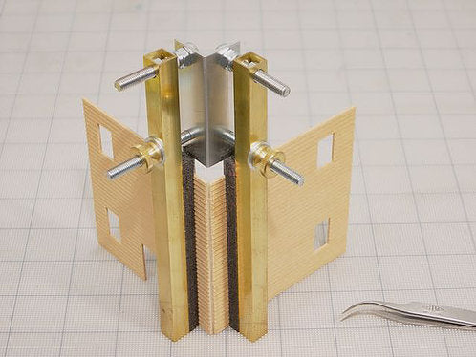
Coffman Right Angle Clamps
Provides steady grip for gluing
Comes in several sizes
MicroMark and B&B sells, too
Link to Buy
Go Back

Slide 10
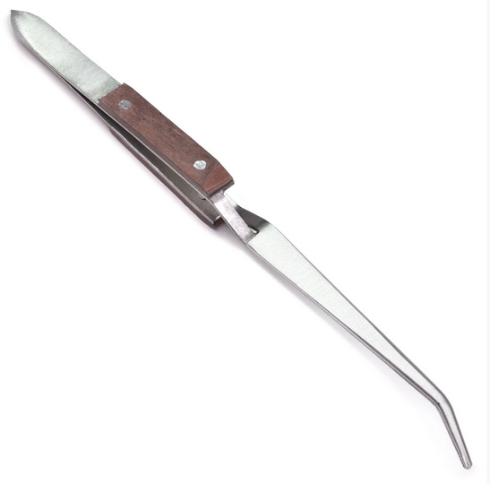
Cross Tweezers
Keeps holding when you let go
Comes in several sizes
Different sizes and tips
B&B carries good selection, too
Link to Buy
Go Back

Slide 11
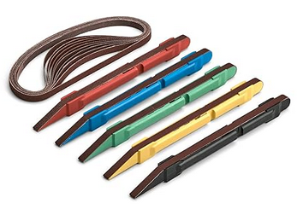
Sanding Sticks
Good for wood
5 different grits
Replaceable, moveable belts
Link to Buy
Go Back

Slide 12
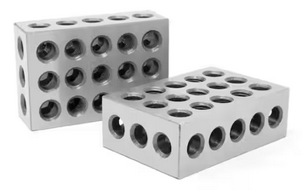
1-2-3 Right Angle Blocks
Keeps right angles when gluing
Solid or with holes
Really heavy as a weight
Link to Buy
Go Back

Slide 13
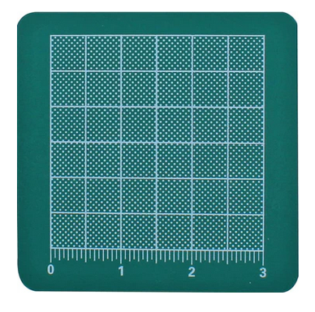
Mini Cutting Mat
Protects your desk
Link to Buy
Go Back

Slide 14
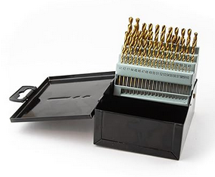
40-60 Drill Index
“Wire Bits” – smaller sizes
Link to Buy
Go Back

Slide 15
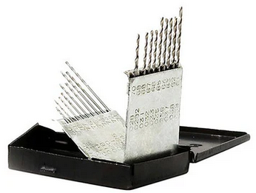
61-80 Drill Index
“Wire Bits” - tiny sizes
Link to Buy
Go Back

Slide 16
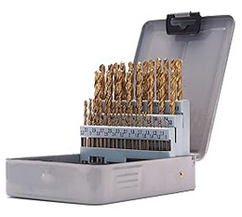
Metric Drill Bits – Big Set
Provides steady grip for gluing
Comes in several sizes
MicroMark and B&B sells, too
Link to Buy
Go Back

Slide 17
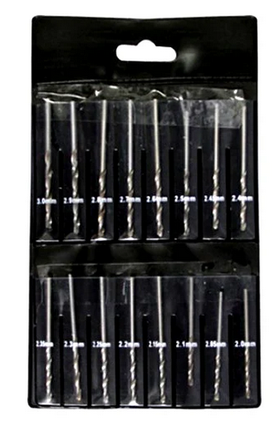
Metric Drill Bits – Less Expensive
Provides steady grip for gluing
Comes in several sizes
MicroMark and B&B sells, too
Link to Buy
Go Back

Slide 18
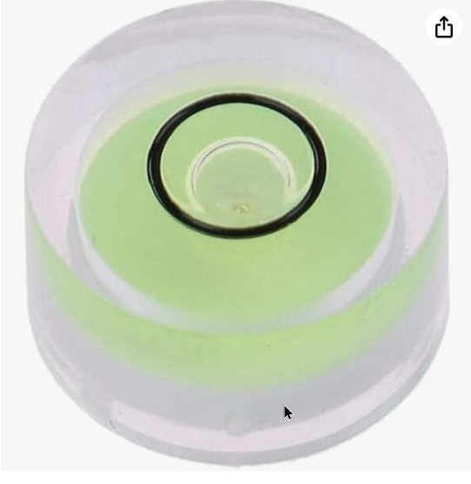
Mini Level & Bull’s Eye Level
Provides steady grip for gluing
Comes in several sizes
MicroMark and B&B sells, too
Link to Buy
Go Back

Slide 19
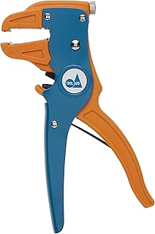
Great Wire Stripper
20-30 gauge
Often find at train shows
Entry level ~ $10 (better than knife)
Nice ones ~$20
Train Shows
Go Back

Slide 20
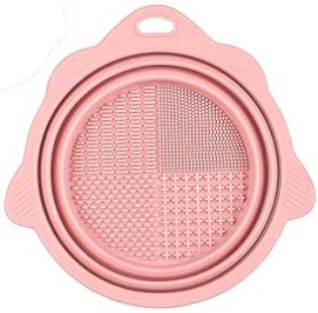
Brush Cleaning Bowl
Fingers to clean acrylics, pastels
Low cost and effective
Link to Buy
Go Back

Slide 21
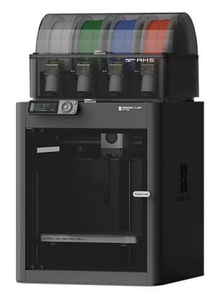
3D Printer
Provides steady grip for gluing
Comes in several sizes
MicroMark and B&B sells, too
Link to Buy
Go Back

Slide 22
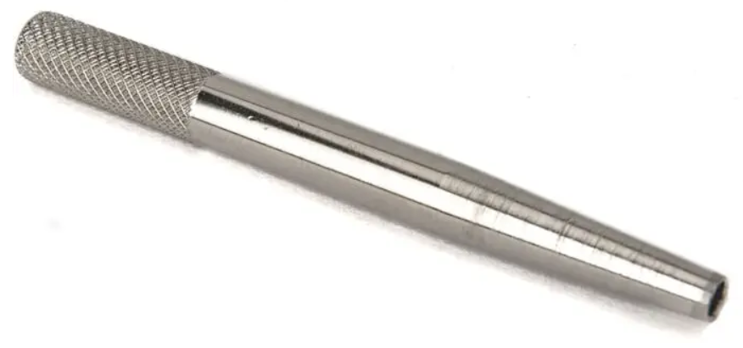
Mini Nut Drivers
Walthers calls these “wrenches”
Hobby store may have on “spinner”
0-80, 1-72, 2-56, 4-40
This hyperlink goes to 2-56
Need to fix link
Link to Buy
Go Back

Slide 23
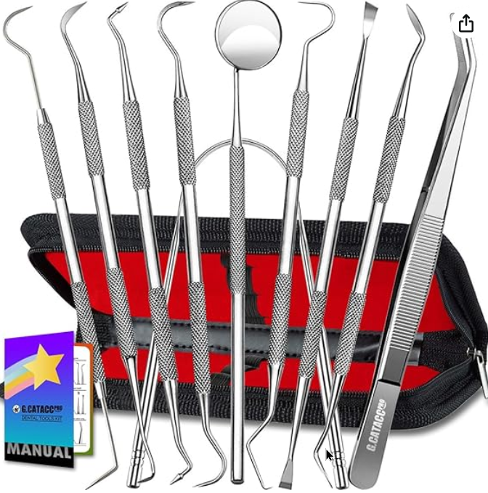
Dental Picks
Sometimes useful
Perhaps your dentist can supply?
Need to fix link
Link to Buy
Go Back

Slide 24
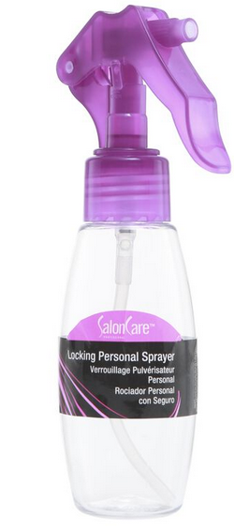
Spray Bottles
Provides steady grip for gluing
Comes in several sizes
MicroMark and B&B sells, too
Link to Buy
Go Back

Slide 25
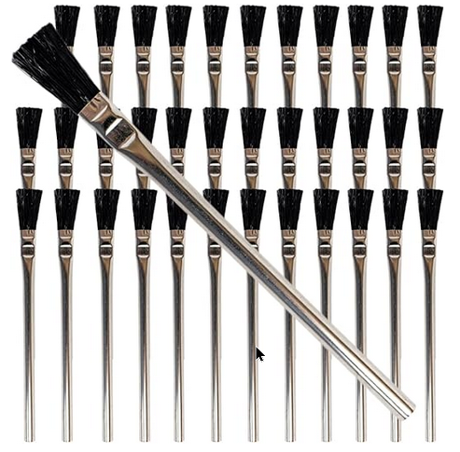
Acid Brushes
Provides steady grip for gluing
Comes in several sizes
MicroMark and B&B sells, too
Link to Buy
Go Back

Slide 26
MakeUp Brushes – Non-Micro
Provides steady grip for gluing
Comes in several sizes
MicroMark and B&B sells, too
Link to Buy
Go Back

Slide 27
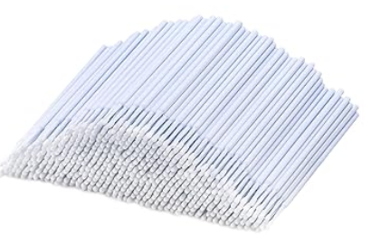
Micro Brushes
Provides steady grip for gluing
Comes in several sizes
MicroMark and B&B sells, too
Link to Buy
Go Back

Slide 28
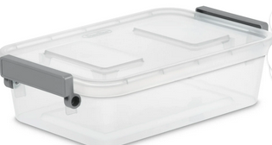
Plastic Storage Containers
Provides steady grip for gluing
Comes in several sizes
MicroMark and B&B sells, too
Link to Buy
Go Back

Slide 29
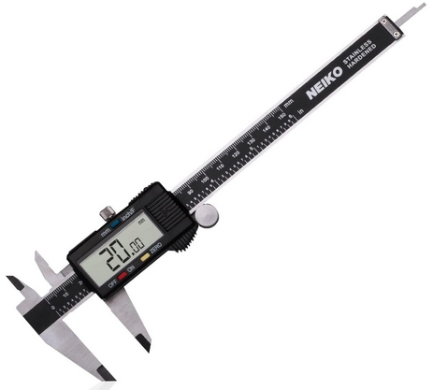
Digital Calipers
Easier than using a ruler
Precision questionable
Repeatable
Link to Buy
Go Back

Slide 30
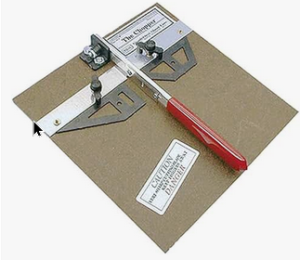
Chopper
Provides steady grip for gluing
Comes in several sizes
MicroMark and B&B sells, too
Link to Buy
Go Back

Slide 31
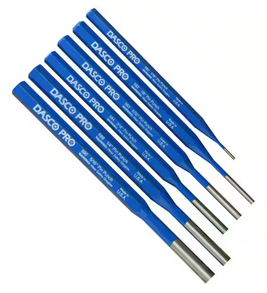
Nail Setter (Punch)
Provides steady grip for gluing
Comes in several sizes
MicroMark and B&B sells, too
Link to Buy
Go Back

Slide 32
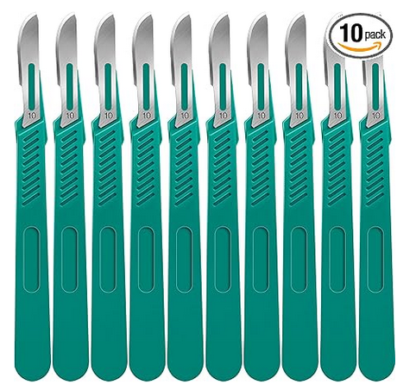
Scalpels
Provides steady grip for gluing
Comes in several sizes
MicroMark and B&B sells, too
Link to Buy
Go Back

Slide 33
Decal Scissors
Lightweight but sturdy
~ $3
My hobby shop ran out!
Go Back

Slide 34
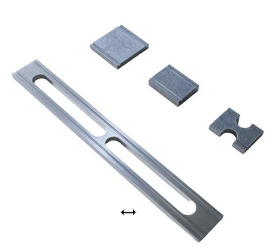
Track Engineering Kit
Provides steady grip for gluing
Comes in several sizes
MicroMark and B&B sells, too
Link to Buy
Go Back

Slide 35
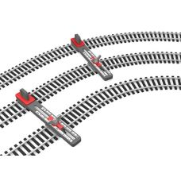
Parallel Track Tool
Constant Spacing
Link to Buy
Go Back

Slide 36
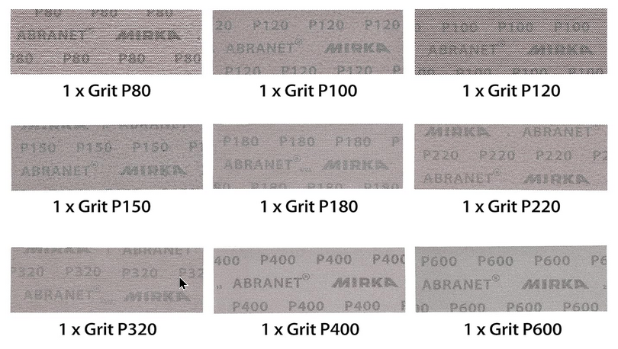
Abranet
Provides steady grip for gluing
Comes in several sizes
MicroMark and B&B sells, too
Link to Buy
Go Back

Slide 37

Soldering Surface
Non Combustible (Corian 4” x 4”)
Link to Buy
Go Back

Slide 38
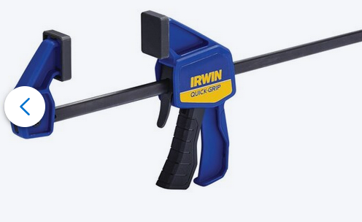
Micro Bar Clamps
Light weight, 4” capacity
Others from Amazon, et al
Link to Buy
Go Back

Slide 39
Reserved for expansion
Notes
Link to Buy
Go Back

Slide 40
Reserved for expansion
Notes
Link to Buy
Go Back

Slide 41
Reserved for expansion
Notes
Link to Buy
Go Back

Slide 42
Reserved for expansion
Notes
Link to Buy
Go Back

Slide 43
Reserved for expansion
Notes
Link to Buy
Go Back

Slide 44
Reserved for expansion
Notes
Link to Buy
Go Back

Slide 45
Reserved for expansion
Notes
Link to Buy
Go Back

Slide 46
Reserved for expansion
Notes
Link to Buy
Go Back

Slide 47
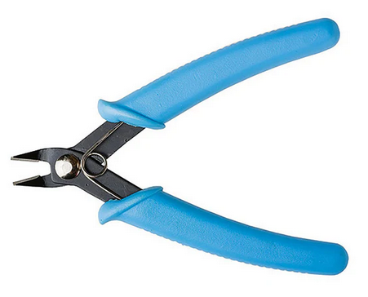
Sprue Cutters
Provides steady grip for gluing
Comes in several sizes
MicroMark and B&B sells, too
Link to Buy
Go Back

Slide 48
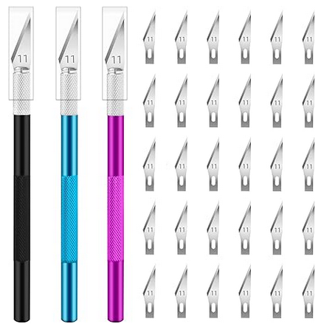
Hobby Knife and Blades
Provides steady grip for gluing
Comes in several sizes
MicroMark and B&B sells, too
Link to Buy
Go Back

Slide 49
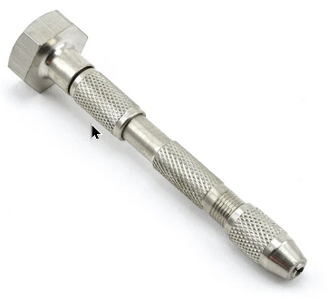
Pin Vise
Provides steady grip for gluing
Comes in several sizes
MicroMark and B&B sells, too
Link to Buy
Go Back

Slide 50
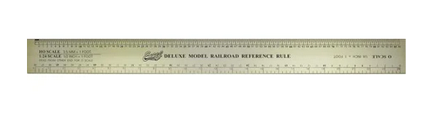
Scale Ruler
Provides steady grip for gluing
Comes in several sizes
MicroMark and B&B sells, too
Link to Buy
Go Back

Slide 51
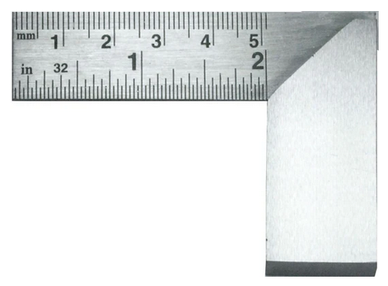
Engineering Square
Provides steady grip for gluing
Comes in several sizes
MicroMark and B&B sells, too
Link to Buy
Go Back

Slide 52
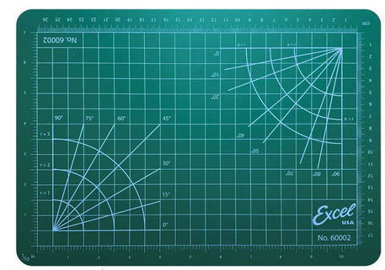
Cutting Mat
Comes in several sizes
Buy just about anywhere
Link to Buy
Go Back

Slide 53
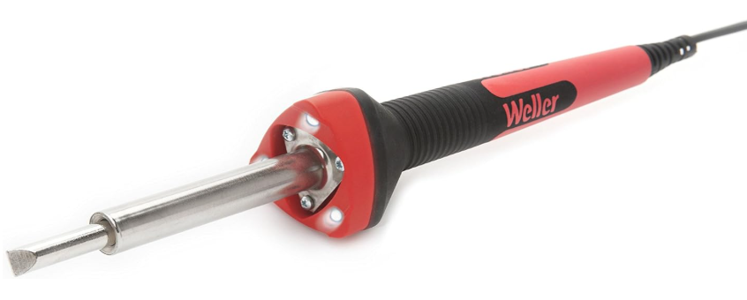
Soldering Iron
Weller 40W With LEDs
Will want pointed tip
Link to Buy
Go Back

Slide 54
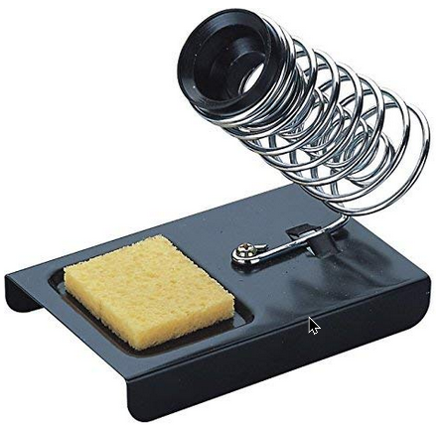
Soldering Iron Holder
Sponge not too useful
Might want a better base (3D Print)
LED night light on power strip
Link to Buy
Go Back

Slide 55
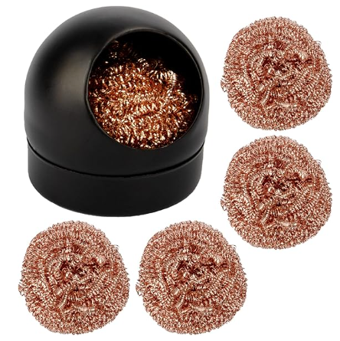
Soldering Iron Tip Cleaner
Plunge tip into ball to clean
Link to Buy
Go Back

Slide 56
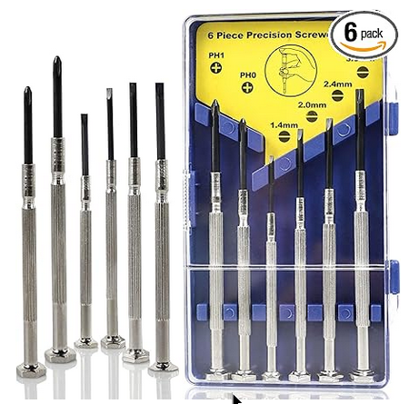
Mini Screw Driver Set
MicroMark and B&B sells, too
How many sets do you need?
Link to Buy
Go Back

Slide 57
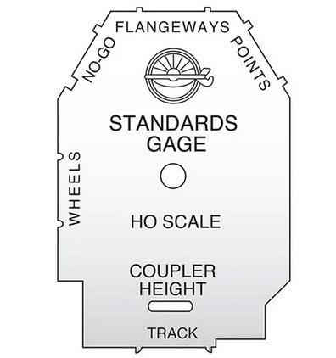
NMRA Track Gauge (HO or as needed)
Provides steady grip for gluing
Comes in several sizes
MicroMark and B&B sells, too
Link to Buy
Go Back

Slide 58
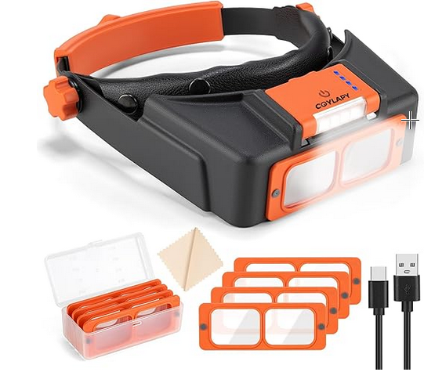
Magnifying Visor
Provides steady grip for gluing
Comes in several sizes
MicroMark and B&B sells, too
Link to Buy
Go Back

Slide 59
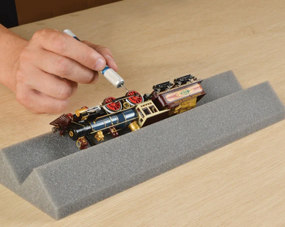
Foam Cradle
Provides steady grip for gluing
Comes in several sizes
MicroMark and B&B sells, too
Link to Buy
Go Back

Slide 60
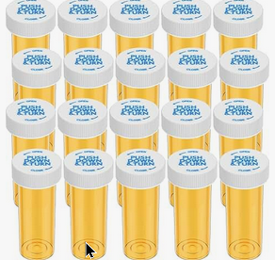
Medicine Bottles
Many different sizes available
Link to Buy
Go Back

Slide 61
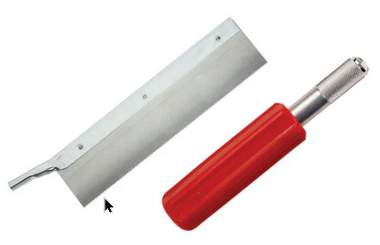
Razor Saw
Provides steady grip for gluing
Comes in several sizes
MicroMark and B&B sells, too
Link to Buy
Go Back

Slide 62
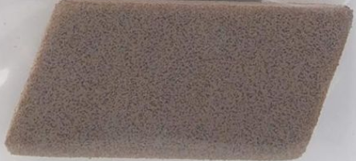
Bright Boy or Equivalent
Cotnraversial choice
Link to Buy
Go Back

Slide 63
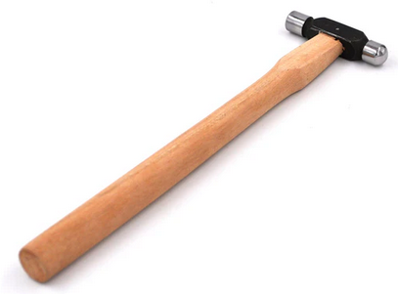
Small Hammer
Not too particular on this
I use my mother’s from 1948
Link to Buy
Go Back

Slide 64
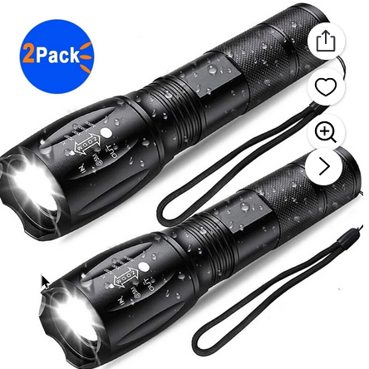
LED Flashlight
Not the inexpensive $2 ones!
Can you ever have enough?
Link to BuyL
Go Back

Slide 65
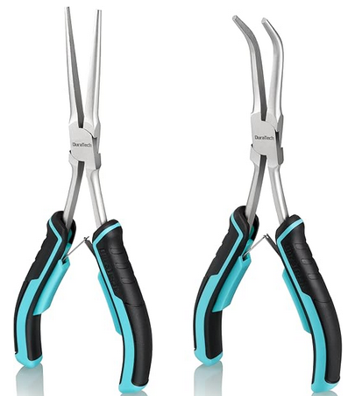
Needle Nose Pliers (various sizes)
I probably have 6-10 of these
Wire cutters, too
Link to Buy
Go Back

Slide 66
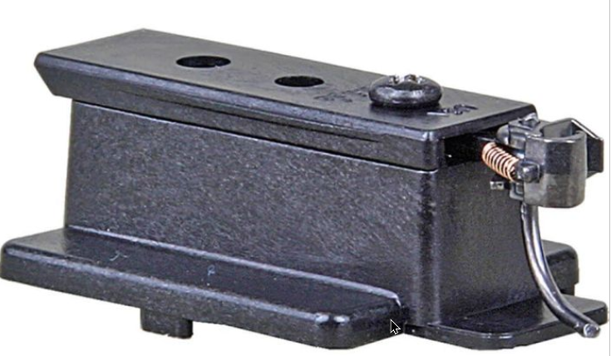
Coupler Gauge
I prefer the plastic one
Don.t forget the “Shims”
There are over and under shanks
Link to Buy
Go Back

Slide 67
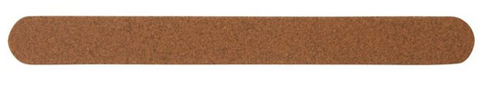
Emory Boards
Inexpensive and handy
Link to Buy
Go Back

Slide 68
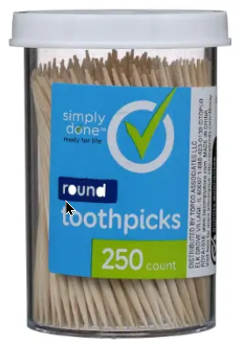
ToothPicks
Mini CA applicators
Inexpensive and handy
Any grocery store
Go Back

Slide 69
Reserved for expansion
Notes
Link to Buy
Go Back

Slide 70
Reserved for expansion
Notes
Link to Buy
Go Back

Slide 71
Reserved for expansion
Notes
Link to Buy
Go Back

Slide 72
Reserved for expansion
Notes
Link to Buy
Go Back

Slide 73
Reserved for expansion
Notes
Link to Buy
Go Back

Slide 74
Reserved for expansion
Notes
Link to Buy
Go Back

Slide 75
Reserved for expansion
Notes
Link to Buy
Go Back

Slide 76
Reserved for expansion
Notes
Link to Buy
Go Back

Slide 77
Reserved for expansion
Notes
Link to Buy
Go Back

Slide 78

Magnetic Right Angle Clamps
Difficult to set in place on model
Adjustable
Link to Buy
Go Back

Slide 79
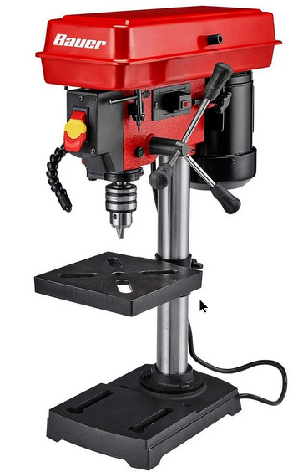
Drill Press
More accurate than hand drill
Many options under $100
Link to Buy
Go Back

Slide 80

Cordless Screw Driver
Light weight, convenient
Hard to justify
Link to Buy
Go Back

Slide 81

Third Hands
With or without magnification
I still can’t justify a set
Link to Buy
Go Back

Slide 82

9V Power Supplies (Wall Warts)
Other voltages available
Link to Buy
Go Back

Slide 83

Barrier Strips
Stable, changeable connection
Spade connectors for wires
Kind of expensive
Link to Buy
Go Back

Slide 84

Suitcase Connectors
Nice, secure, expensive ($0.87 ea)
Less expensive bulk from Amazon
FreeMo suggests their use
Link to Buy
Go Back

Slide 85

Arduinos et al
Programmable microcomputer
Basis for animation
Need a programming background
Link to Buy
Go Back

Slide 86

Round Forming Pliers
Adjust Couplers
Link to Buy
Go Back

Slide 87

Scratch Awl
Not sure I eally need this
Link to Buy
Go Back

Slide 88

9V Battery Connector
Handy for portable power
Link to Buy
Go Back

Slide 89

#17 or #18 Hobby Knife Blade
Handy for scraping
Probably cheaper in bulk
Link to Buy
Go Back

Slide 90

#11 Hobby Knife Blade (600 Count)
Provides steady grip for gluing
Comes in several sizes
MicroMark and B&B sells, too
Link to Buy
Go Back

Slide 91

Dremel Tool (or equivalent)
Don’t use mine very much
Link to Buy
Go Back

Slide 92

Needle File Set
Don’t use mine very much
Link to Buy
Go Back

Slide 93

Heat Gun and Shrink Wrap
Surprisingly useful
Don’t forget the shrink wrap
Link to Buy
Go Back

Slide 94

Magnetic Bowl
Several convenient sources
You know you need more than one
Link to Buy
Go Back

Slide 95

Magnetizer
Commonly available
Useful for small screwdrivers
Useful in tight places
Link to Buy
Go Back

Slide 96

Make Up Brushes – Non Micro
Useful for weathering
Less expensive option available?
Link to Buy
Go Back

Slide 97

Volt Meter
Haven’t tried this model
Check out Walmart, Home depot
Link to Buy
Go Back

Slide 98

Alligator Leads
Useful, convenient
Commonly available
Link to Buy
Go Back

Slide 99

Decal Paper
White background available, too
Link to Buy
Go Back

Slide 100

Foil (Transparency) Film
Ink Jet compatible
Better for windows than decals
Link to Buy
Go Back

Slide 101

Wire Bender
Purchased, but haven’t tried yet
Functional goose-neck lamps
Link to Buy
Go Back

Slide 102

Hemostats
Don’t use these much
Link to Buy
Go Back

Slide 103

Postal Scale
Weigh your cars
Link to Buy
Go Back

Slide 104

Track Cutter
Better than hobby saw?
Link to Buy
Go Back

Slide 105

Make Up Sponges
Bought but haven’t tried
Might be useful for weathering
Link to Buy
Go Back

Slide 106
Reserved for expansion
Notes
Link to Buy
Go Back

Slide 107
Reserved for expansion
Notes
Link to Buy
Go Back

Slide 108
Reserved for expansion
Notes
Link to Buy
Go Back

Slide 109
Reserved for expansion
Notes
Link to Buy
Go Back

Slide 110
Reserved for expansion
Notes
Link to Buy
Go Back

Slide 111
Reserved for expansion
Notes
Link to Buy
Go Back

Slide 112
Reserved for expansion
Notes
Link to Buy
Go Back

Slide 113
Reserved for expansion
Notes
Link to Buy
Go Back

Slide 114
Reserved for expansion
Notes
Link to Buy
Go Back

Slide 115
Reserved for expansion
Notes
Link to Buy
Go Back

Slide 116

Mod Podge
Adhesive
Useful for rocks on horizontal surface
Link to Buy
Go Back

Slide 117

Liquid Electrical Insulation Tape
Commonly available locally
Messy, but easier than shrink wrap
Link to Buy
Go Back

Slide 118

Pan Pastels (a la carte)
Earth tones, grays for weathering
Art stores have these, Amazon, too
Singles and sets
Link to Buy
Go Back

Slide 119
Weathering Brushes
Provides steady grip for gluing
Comes in several sizes
MicroMark and B&B sells, too
Link to Buy
Go Back

Slide 120

Automotive Masking Tape
1/16” to 1/2” wide
Useful for masking details
Link to Buy
Go Back

Slide 121

Micro Set for Decals
Prep before decaling
Commonly available in hobby shops
Link to Buy
Go Back

Slide 122

Brush Cleaning Soap
Works, well , but better than Dawn?
Link to Buy
Go Back

Slide 123
Reserved for expansion
Notes
Link to Buy
Go Back

Slide 124
Reserved for expansion
Notes
Link to Buy
Go Back

Slide 125
Reserved for expansion
Notes
Link to Buy
Go Back

Slide 126
Reserved for expansion
Notes
Link to Buy
Go Back

Slide 127
Reserved for expansion
Notes
Link to Buy
Go Back

Slide 128
Reserved for expansion
Notes
Link to Buy
Go Back

Slide 129
Reserved for expansion
Notes
Link to Buy
Go Back

Slide 130
Reserved for expansion
Notes
Link to Buy
Go Back

Slide 131
Reserved for expansion
Notes
Link to Buy
Go Back

Slide 132
Reserved for expansion
Notes
Link to Buy
Go Back

Slide 133
Local Hobby Shop
Link to Buy
Go Back

Slide 134

MicroMark
Link to Buy
Go Back

Slide 135

B&B Hobby Supplies (“The Tool Guy”)
Link to Buy
Go Back

Slide 136

Sally Beauty Supply
Link to Buy
Go Back

Slide 137

Harbor Freight
Link to Buy
Go Back

Slide 138

Amazon
Link to Buy
Go Back

Slide 139

Michaels
Link to Buy
Go Back

Slide 140

Walmart
Link to Buy
Go Back

Slide 141

Home Depot
Link to Buy
Go Back

